Slide 1
Update inputs and more

Slide 2
Updates

Slide 3
Updates & Observe Events
Any time you wish to update part of your UI you will need to include an event observer.
Here you will be observing an input that your user can interact with
Observers can be done in one of two ways. Event observers or generic observer function
observeEvent() when you are observing a particular input
observe() works if you want to observe multiple things, or non-input based object such as the output or content of a reactive function.

Slide 4
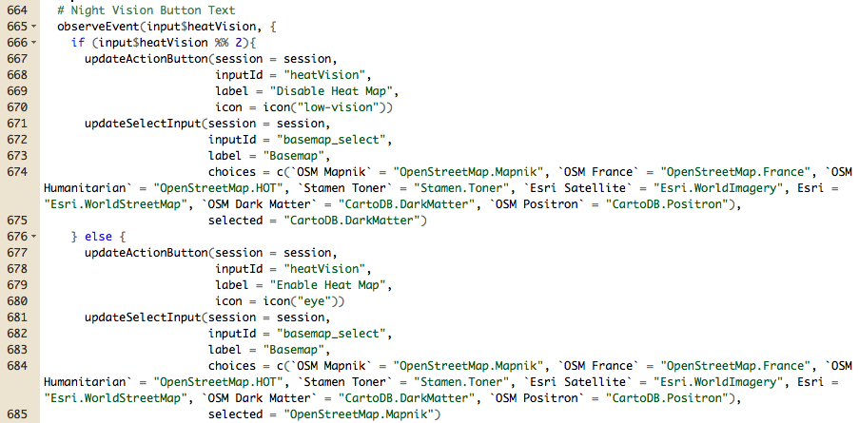

Slide 5
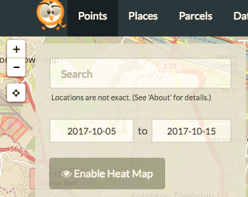
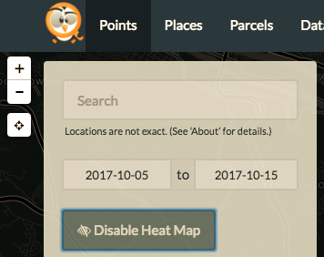
Before: After:

Slide 6
Notifications

Slide 7
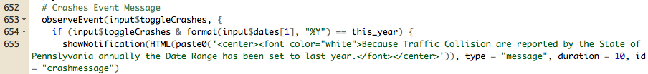
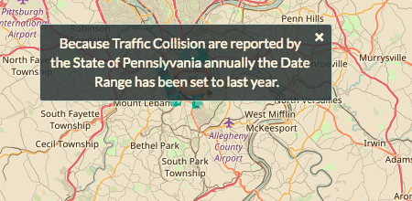
Notification Example

Slide 8
Bookmarking

Slide 9
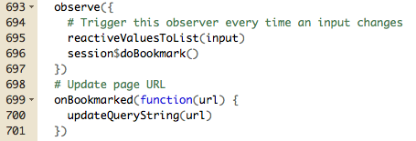
Bookmarking Example

Slide 10
Progress Bars

Slide 11
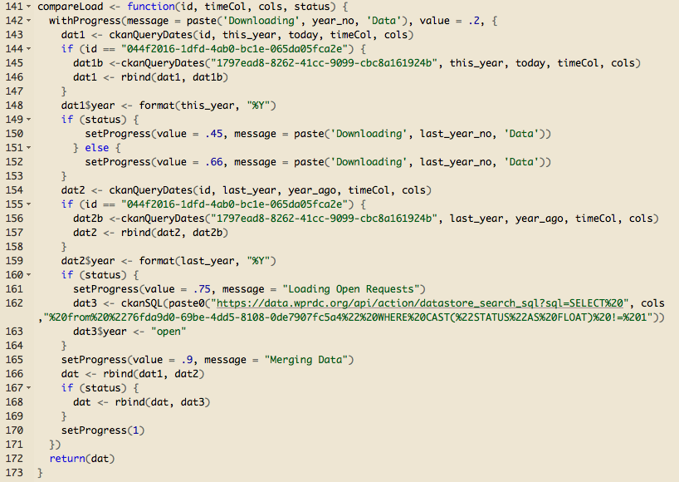
Progress Bar Example

